Slide 1

LESSION 2 – Lean on
For my sweetheart

Slide 2
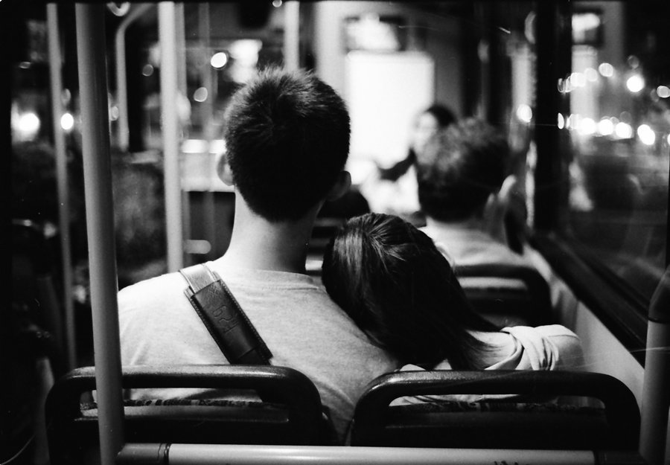
lean on
She’s leaning on the pillar
We need someone to lean on

Slide 3
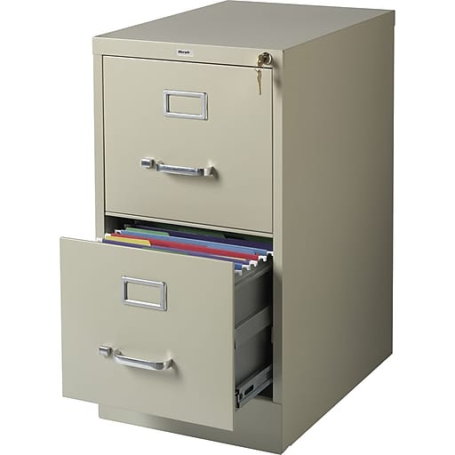
cabinet
filing cabinet

Slide 4
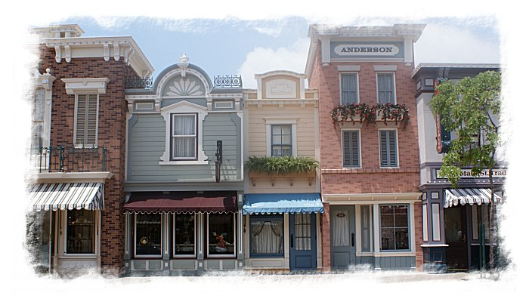
close
The filing cabinet is closed
close to
My house is close to your house

Slide 5
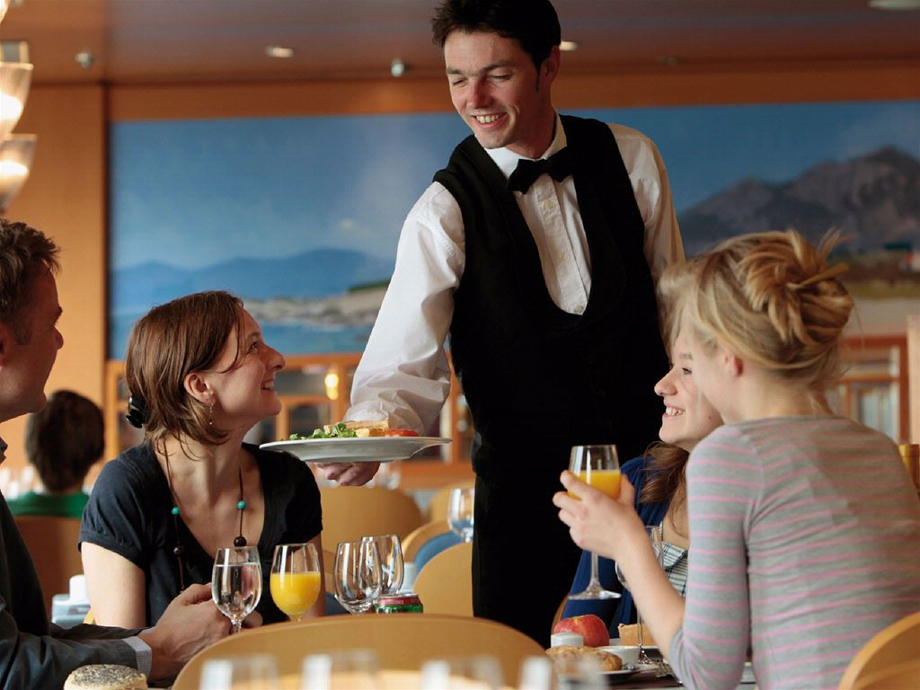
serve
They are being served by the waitress
The man is serving the customers

Slide 6
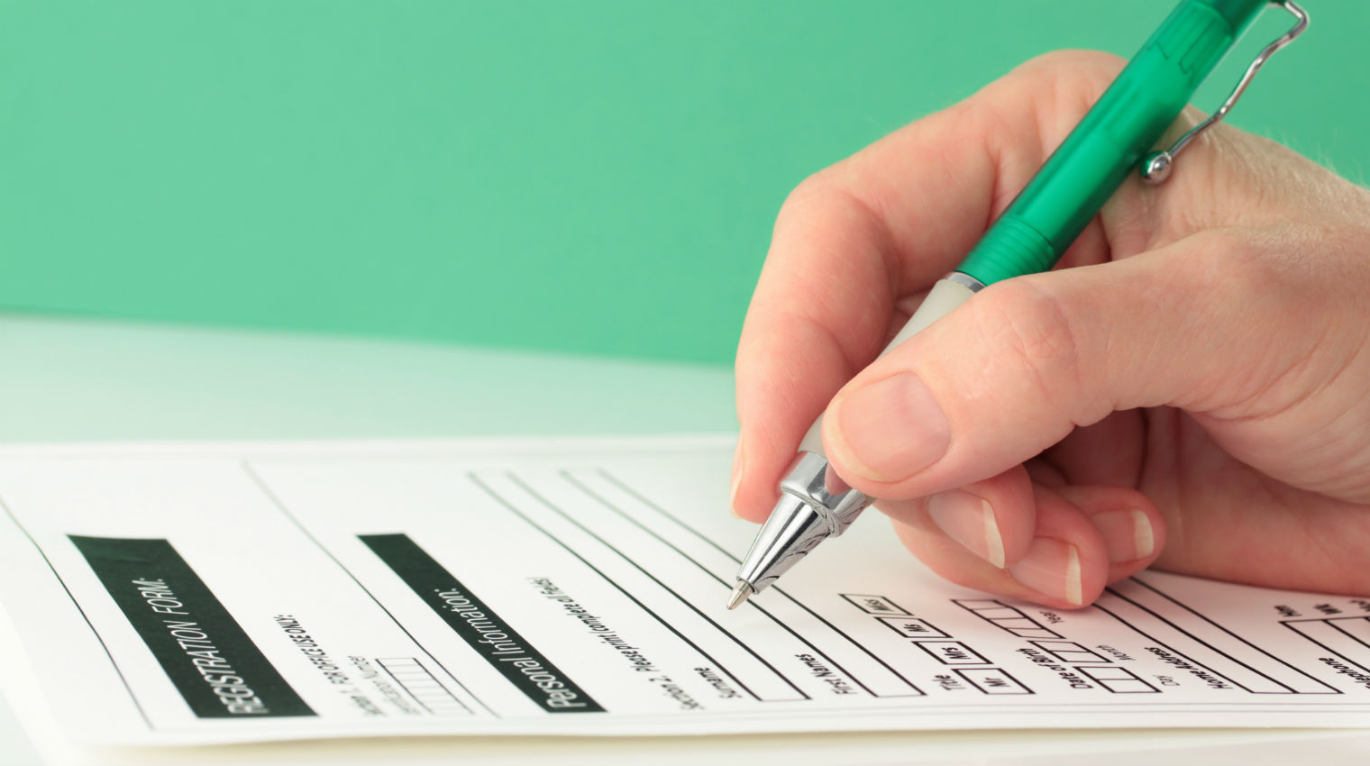
fill out
He is filling out a form

Slide 7
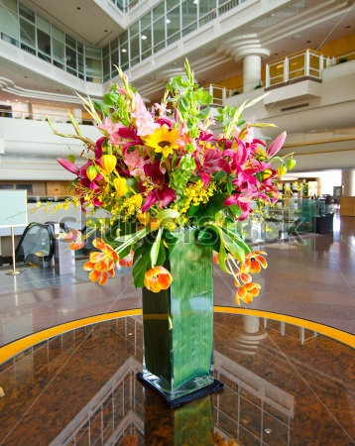
vase
There is a vase on the table
There are 2 vases on the table

Slide 8
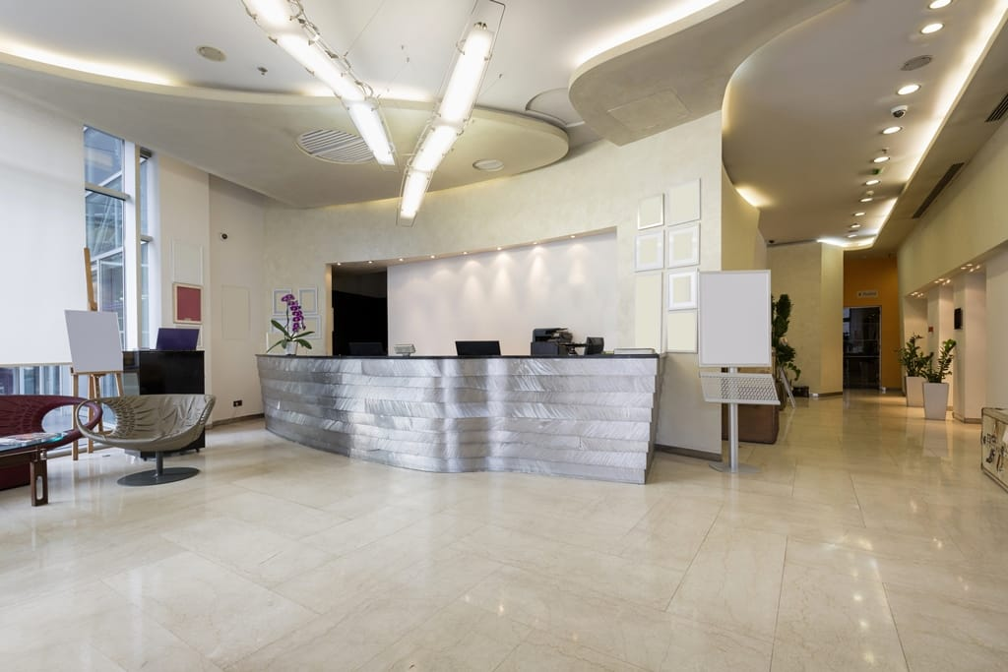
lobby
I’m standing in the lobby

Slide 9
http://www.onthitoeic.vn/part-1-level-350-500-bai-luyen-tap-50/

